Slide 1


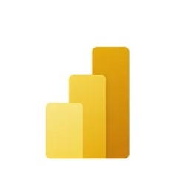

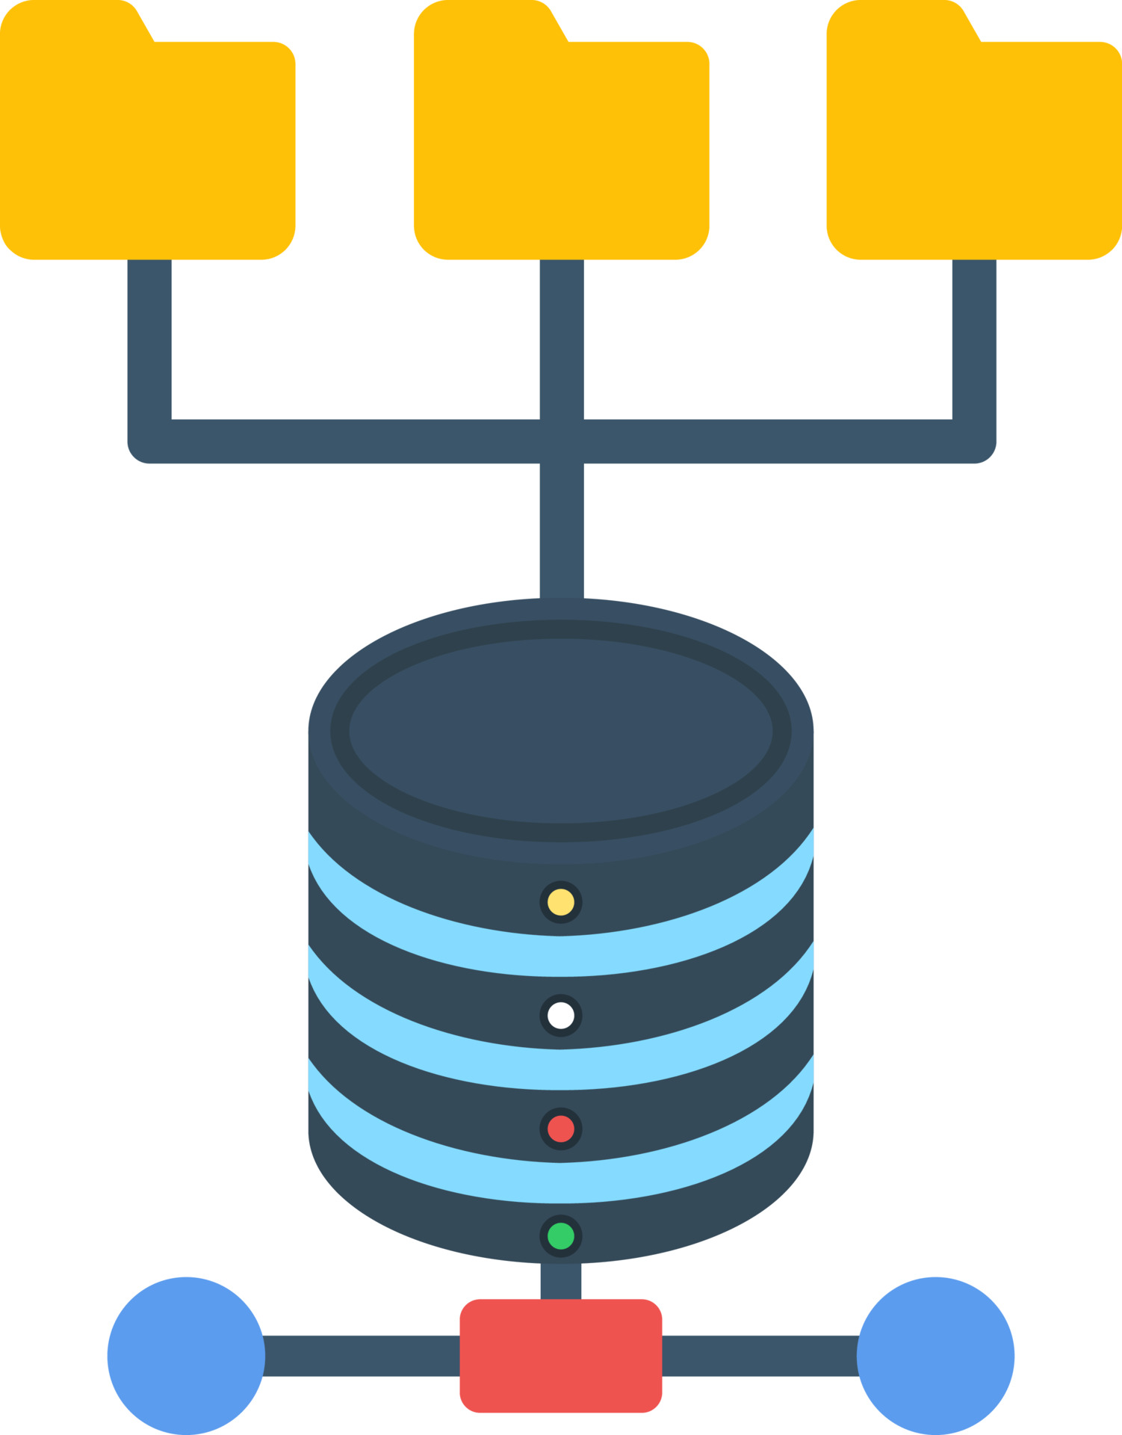

Analytics
Azure Synapse Analytics
Dashboard
Power BI
Data Integration
Data Factory
Transformation
Azure Databricks
Data Source
Raw Data Source
Data Lake Gen 2
Transformed Data
Data Lake Gen 2

